Slide 1
The Young and the Credit-less
Lauren Tayara, Robert Troutman, Becca Gerdon,
Surafel Gebre-Yesus, Christina Sullivan
Notes:
Chirstina

Slide 2

Project Research Question
How do we create a model that helps institutions avoid risk of young loan applicants yet allows the young applicants the opportunity to gain credit?
Our group chose this question to bring attention to the little knowledge that young loan applicants have. Based on our findings in our models we show that:
Which age group is the least likely to apply for loans?
Which group is most likely to default on loans?
Notes:
Christina

Slide 3

Machine Learning Model
The dataset is going to be used to create a binary classification model using a deep neural network to determine loan approval, focusing on the younger demographic. This model contains 11 numerical variables, some of which were string variables that had to be converted to binary, giving us 26 variables total, in order to build the best model.
Notes:
Robert

Slide 4
Data Preparation and Model Training Process
First we read in the data we retrieved from Kaggle, and dropped all null values in the dataset.
Then, using Pandas get_dummies feature, we were able to convert any string variables into binary allowing the data to be used to build a model.
After selecting our X and y, we then trained our data, scaled/fit data, and transformed data, in order to build our model.
Using Tensorflow we made a LSTM model with a dropout percentage, to randomly drop 20% of the units on each epoch.
Finally, we compiled and trained the model,
Notes:
Robert

Slide 5
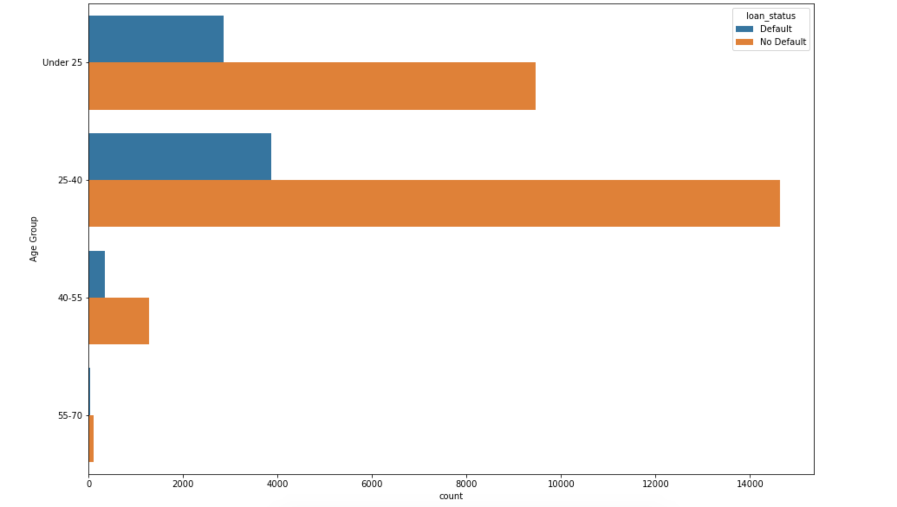
Techniques Used to Evaluate Model
Created plots to visualize how different factors affected loan status:
Age groups
And what is the ratio of good loans to bad loans for the age groups
Homeownership status
Loan Intent
Previous default on loan or not
Notes:
Becca

Slide 7
StatsModel
R-squared reflects the fit of the model. R-squared values range from 0 to 1, where a higher value generally indicates a better fit, assuming certain conditions are met. (OUR SCORE .03)
const coefficient is your Y-intercept. It means that if both the person age and loan amount coefficients are zero, then the expected output (i.e., the Y) would be equal to the const coefficient.
Interest_Rate coefficient represents the change in the output Y due to a change of one unit in the interest rate (everything else held constant)
Considered as the R of Python
OLS MODEL (Ordinary List Square)- A type of model used to estimate the unknown parameter in a linear regression model. Helps to minimize the difference between observed and predicted values
The t score is a ratio between the difference between two groups and the difference within the groups. The larger the t score, the more difference there is between groups. The smaller the t score, the more similarity there is between groups. OUR SCORE 9.179
Notes:
Surafel

Slide 8
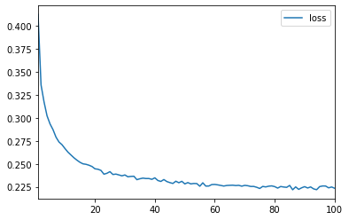
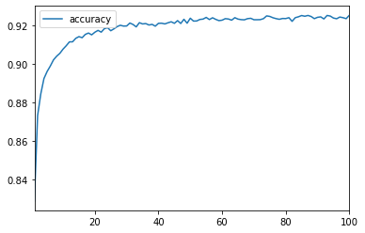
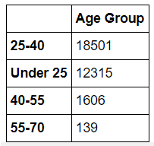
Findings and Summary
Findings: 92.2% accuracy for predicting loan status but had a 22.5% loss.
Out of all of the age groups 25 and under is the least likely to apply for loans (besides 55 and over, who would be the least)
This group is most likely to default on loans.
Summary: Although the 25-40 age group clearly had the most applicants the Under 25 category was more likely to default with 23.2%.(25-40 had 20.9%)
Notes:
Lauren

Slide 9
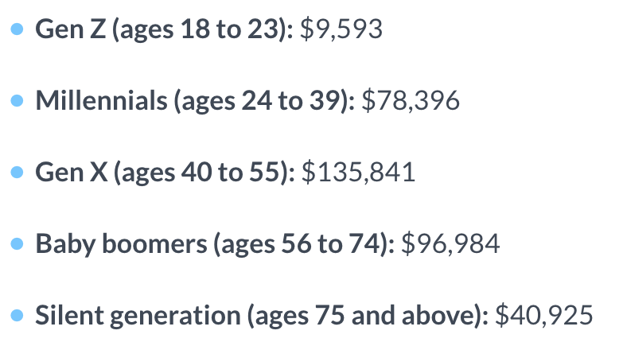
Average Debt Balance by Age Group
This graph shows the average debt balance, whether it be loans or credit cards, that the different generations have to date.
Gen X has the highest debt rate in credit cards, auto loans student loans and mortgage loans.
Seeing how Gen X is in the age range of 40-55, their debt balance is much higher due to kids going to college, paying off the mortgage and loans for kids cars.
Notes:
Christina

Slide 10

Implications
Why don’t people from this group take out more loans?
Why are they more likely to default on loans?
This age group might need more education on credit and loans
Notes:
Lauren and others join in

Slide 11

QnA Bot
Using AWS QnA Bot, we created a tool that is aimed to test the user’s credit knowledge and give them a score at the end
We input a question, a correct answer, and three incorrect answers for the user to choose from
Once the user selects an answer, the bot tells them whether they were correct or not and if not it shows the correct answer
We also intended for this to be helpful for younger individuals to learn about what credit is and how they can improve their score
https://jpya3ma0d8.execute-api.us-west-2.amazonaws.com/prod/static/client.html
Notes:
Lauren and Becca

Slide 12
Sources
https://www.consumerfinance.gov/ask-cfpb/what-information-do-i-have-to-provide-a-lender-in-order-to-receive-a-loan-estimate-en-1987/
https://blog.bitsrc.io/top-5-javascript-machine-learning-libraries-604e52acb548
https://www.lendingtree.com/personal/personal-loans-statistics/
https://data.world/nerb/sba-loan-guarantee-data
https://www.lendingclub.com/info/statistics.action
https://data.world/cityofchicago/chicago-microlending-institute-cmi-microloans
https://data.world/data-ny-gov/22ew-dxez
https://www.cnbc.com/select/average-american-debt-by-age

